Slide 1
3d pose estimation via point pair featurs
Tolga Birdal

Slide 2
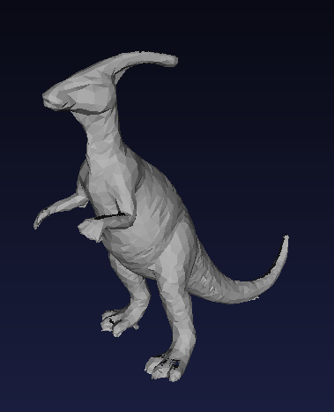
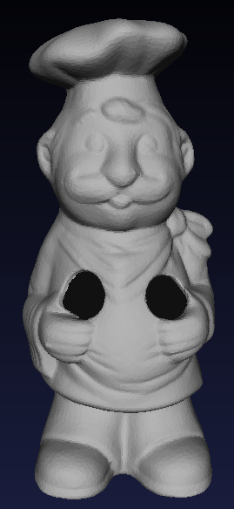
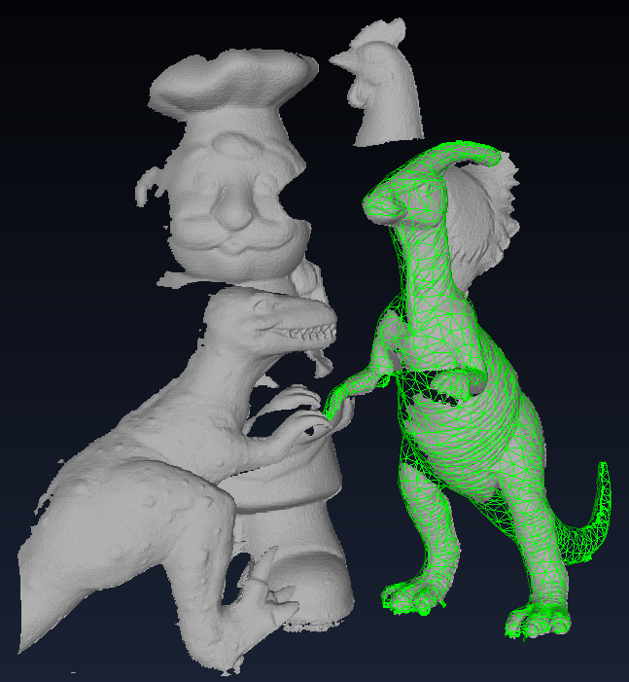
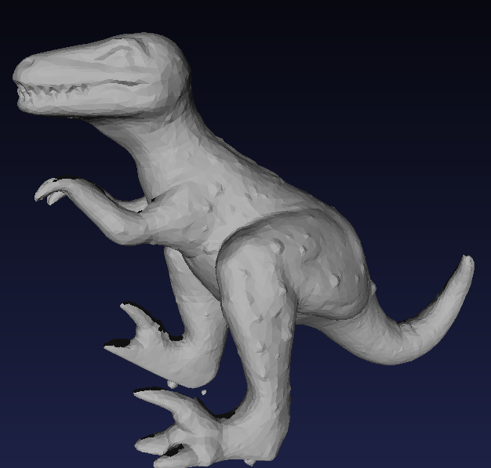
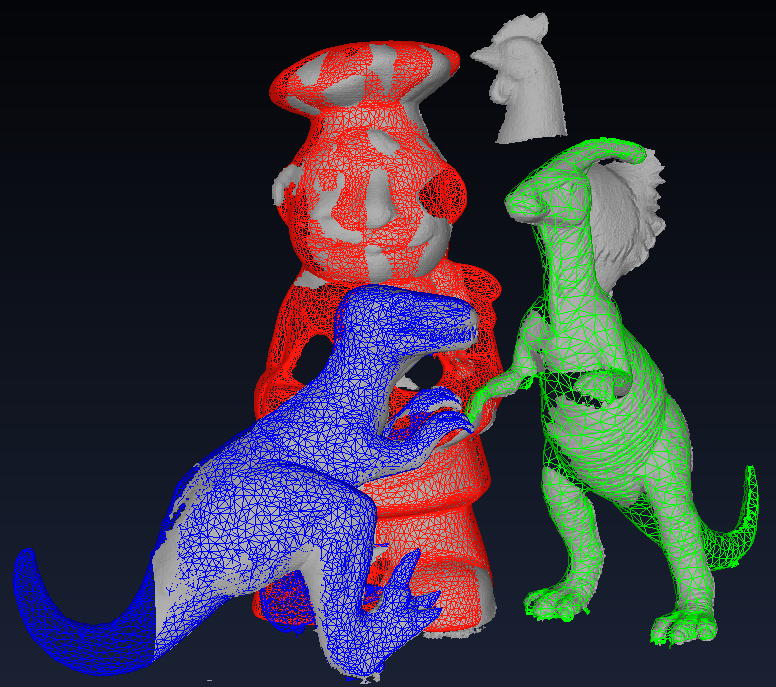
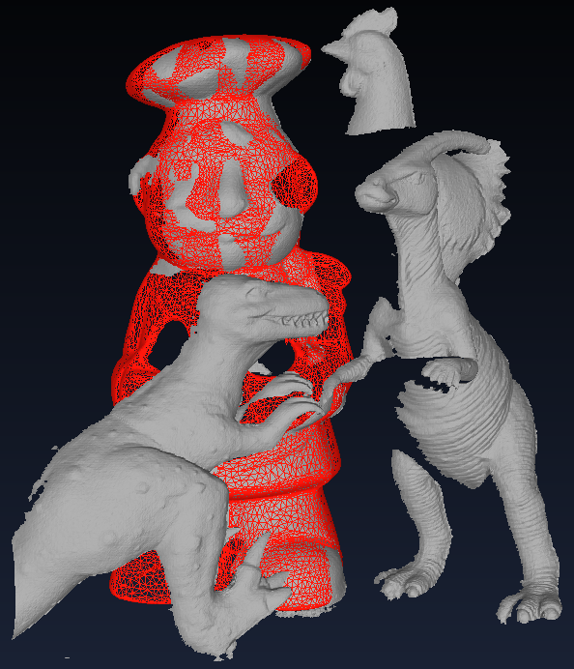
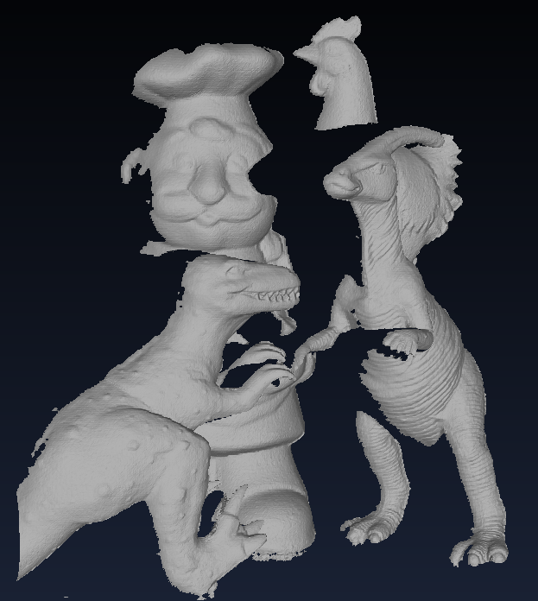
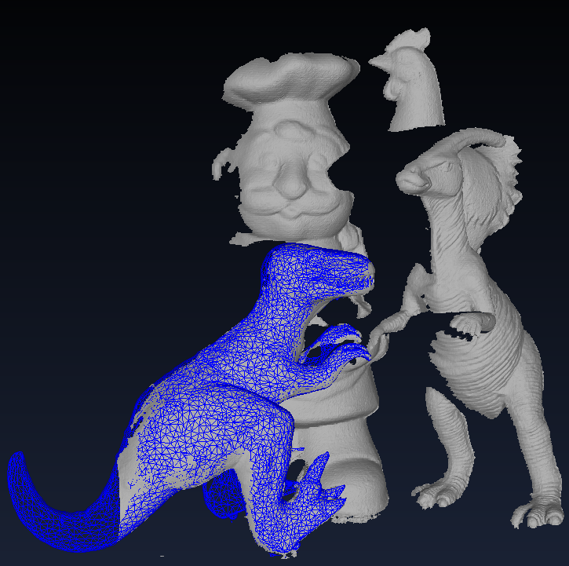
Registration using point pair features - LASER
Input 3D Models
PPF + ICP
All Models
Full Pose Estimation
Input 3D Scene
Registrations

Slide 3
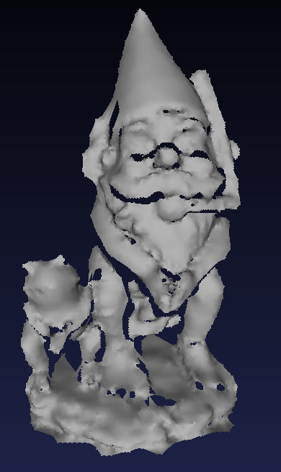
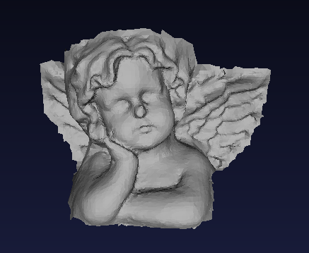
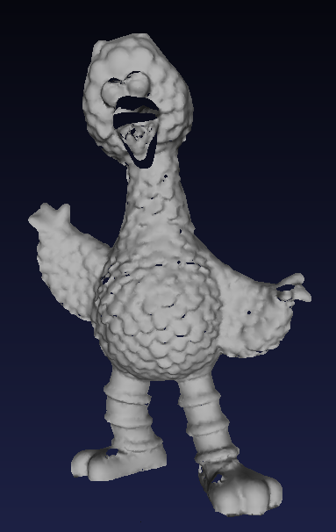
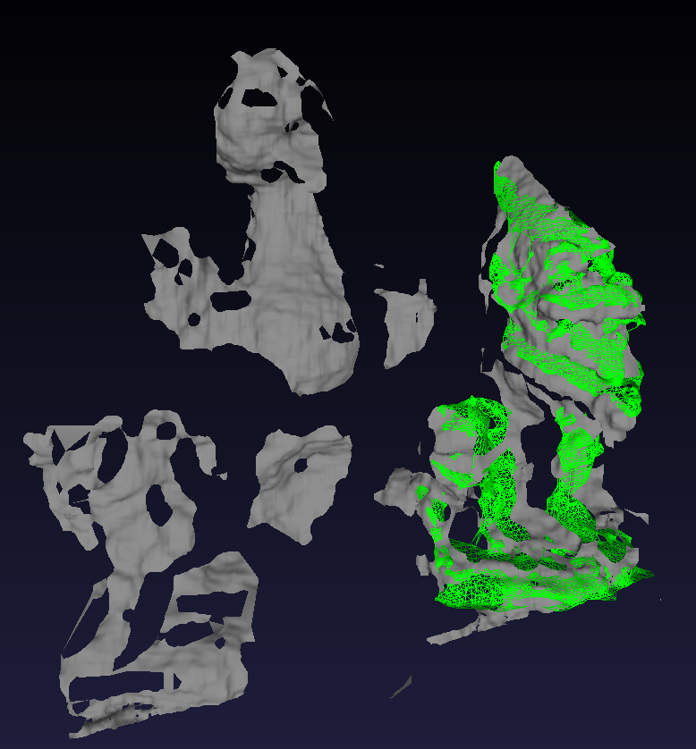
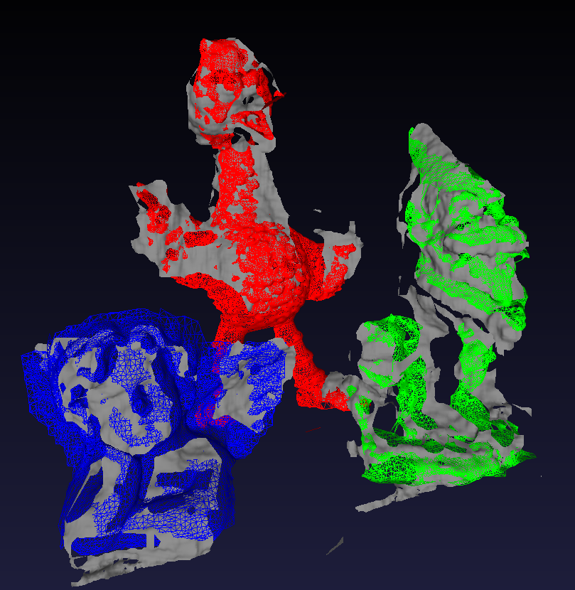
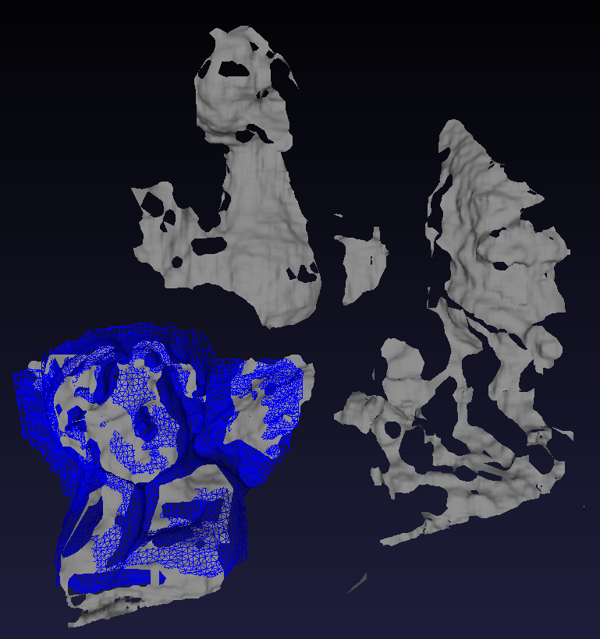
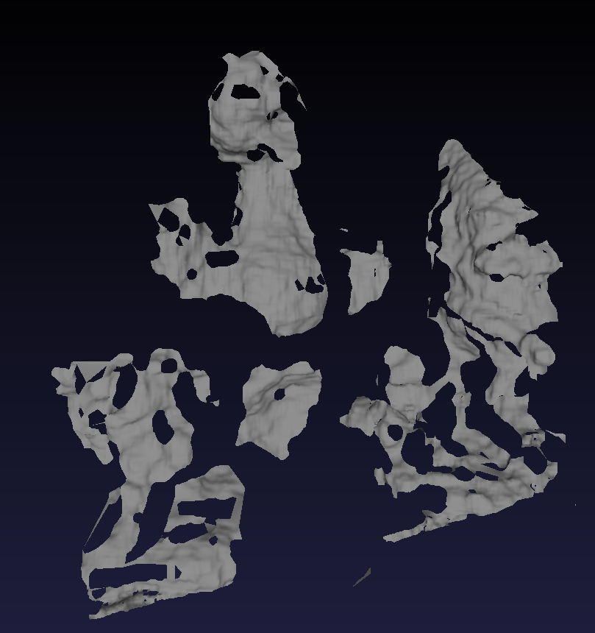
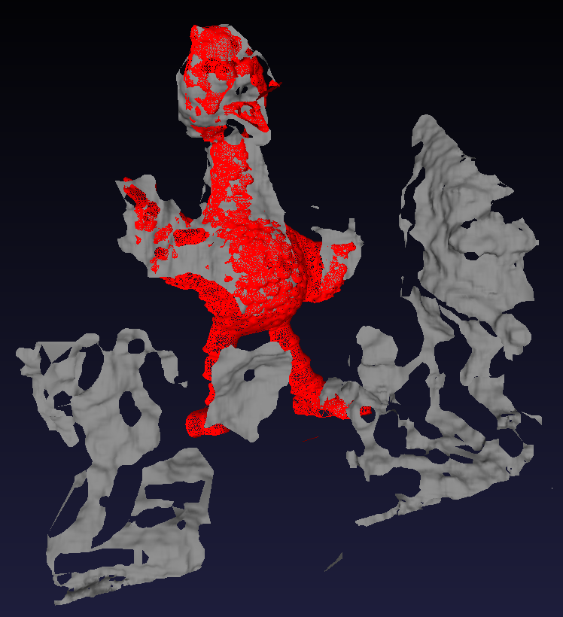
Registration using point pair features - STEREO
Input 3D Models
PPF + ICP
All Models
Full Pose Estimation
Input 3D Scene
Registrations

Slide 4
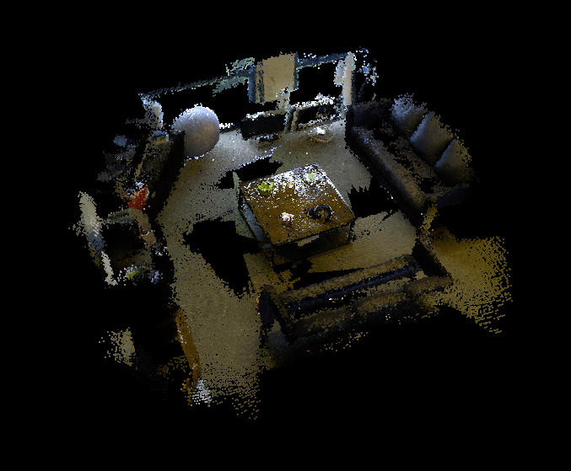
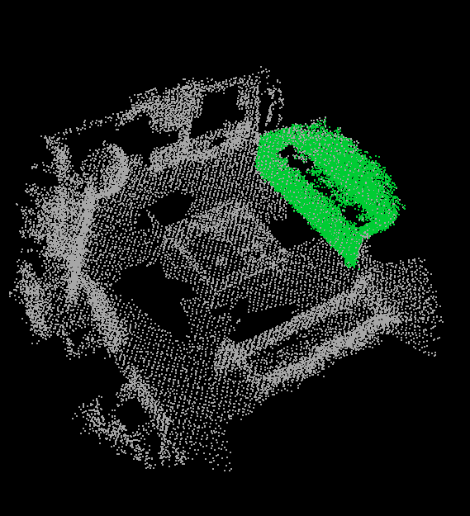
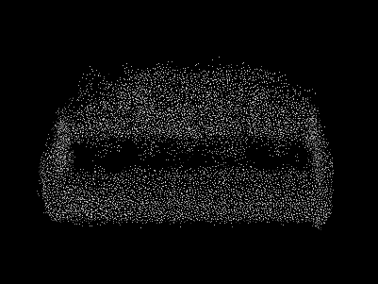
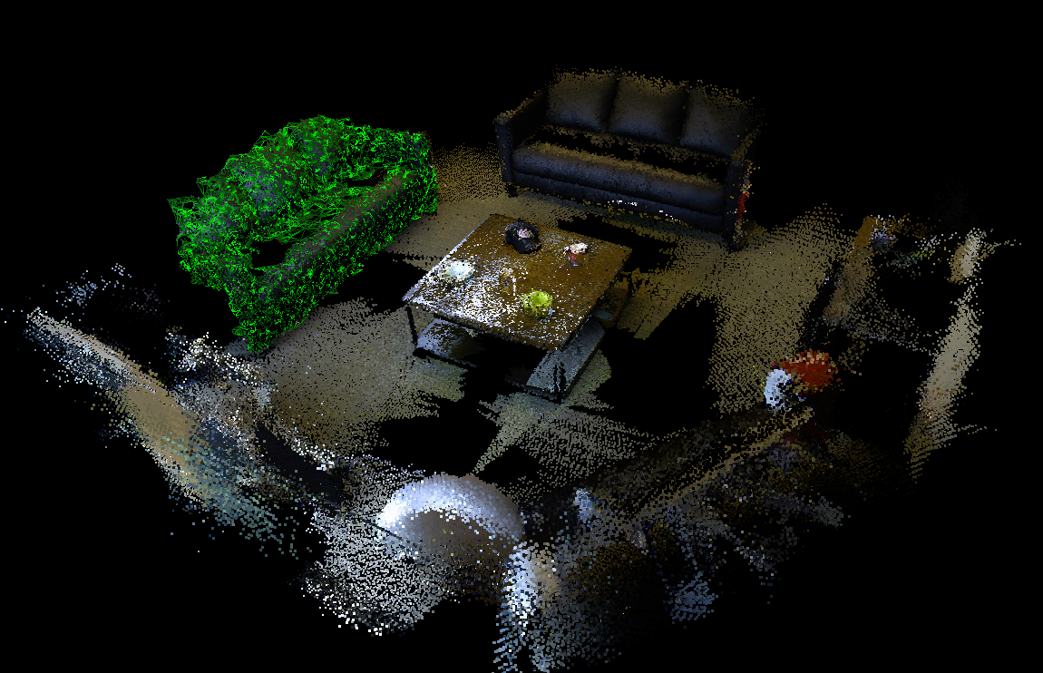
Registration on slam dataset - kinect
Arbitrary SLAM Scene
PPF + ICP
Exact Sofa Model
Registered Pose

Slide 5
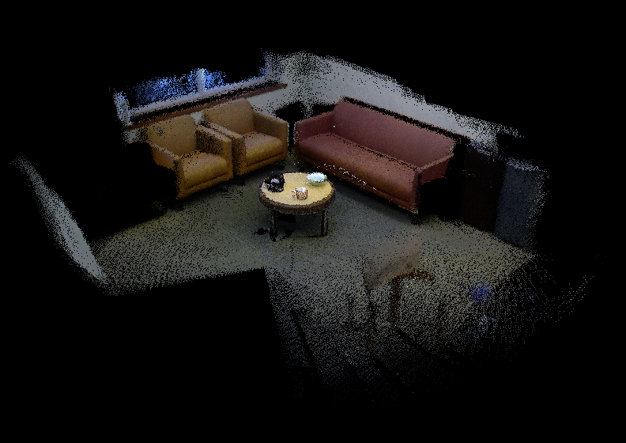
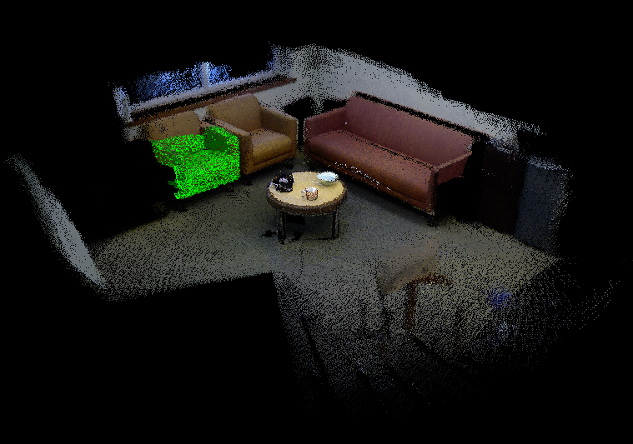
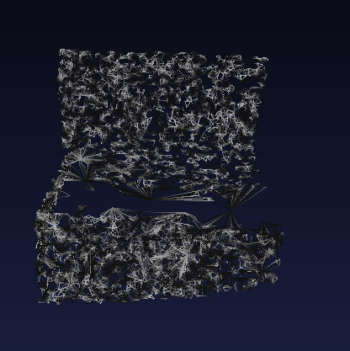
Registration on slam dataset – Kinect 2
3D Reconstruction
PPF + ICP
Model Matched to Reconstruction
Cropped & Processed Chair Model

Slide 6
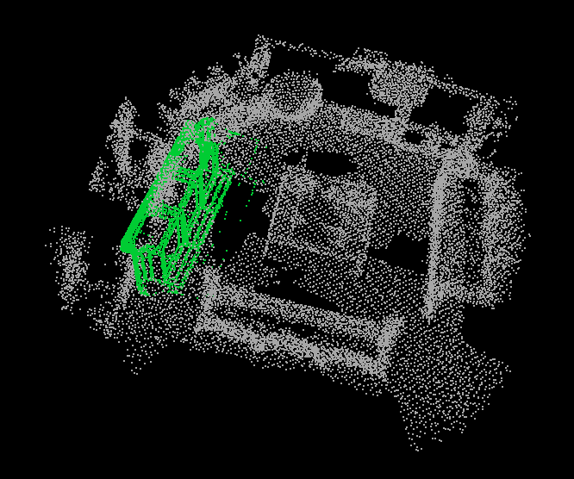
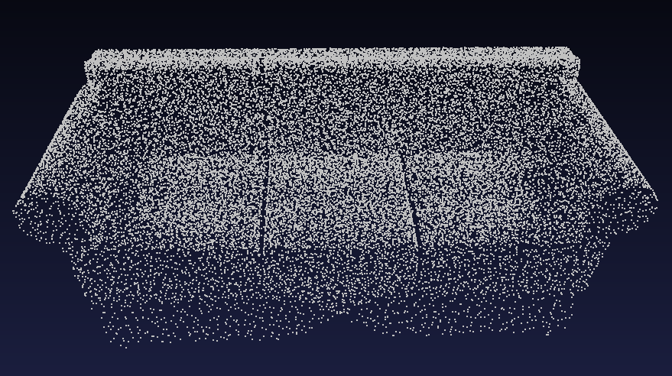
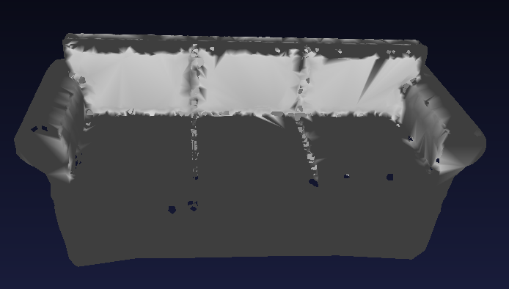
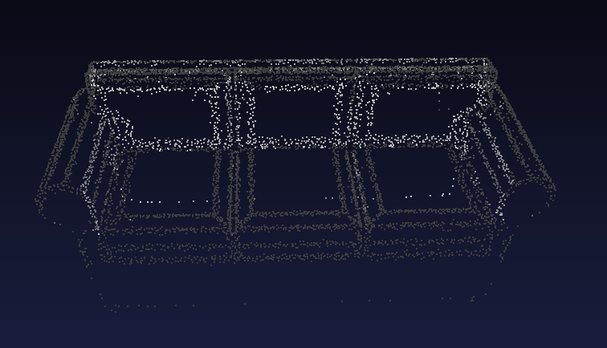
Failing cases
1
4
Model is Positioned with Error
Arbitrary Sofa Model
Train & Match
2
Non-Uniform Sampling & Normals Computation
3
Scaled and ReMeshed

Slide 7
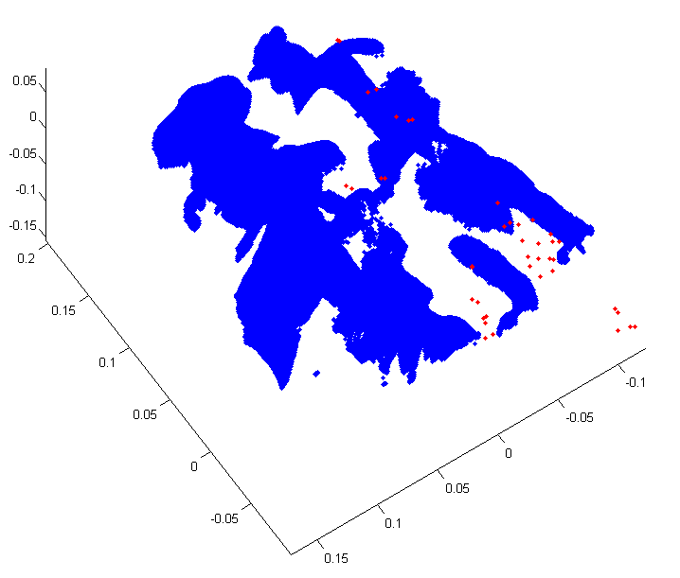
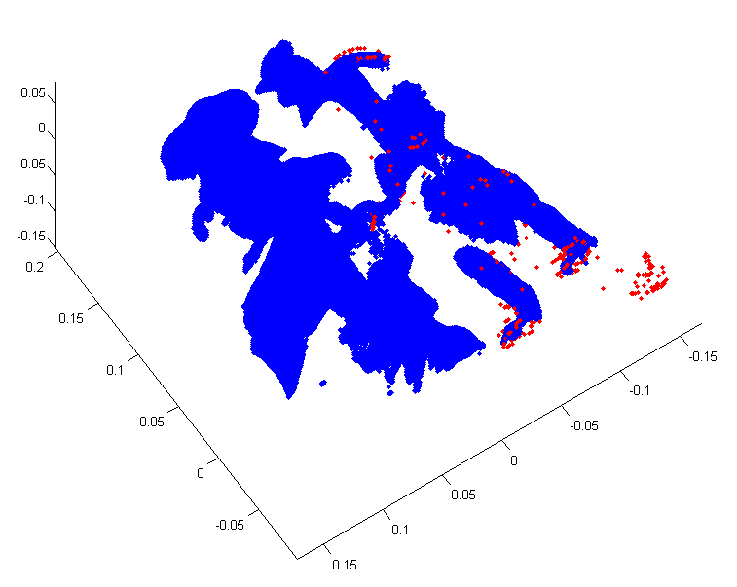
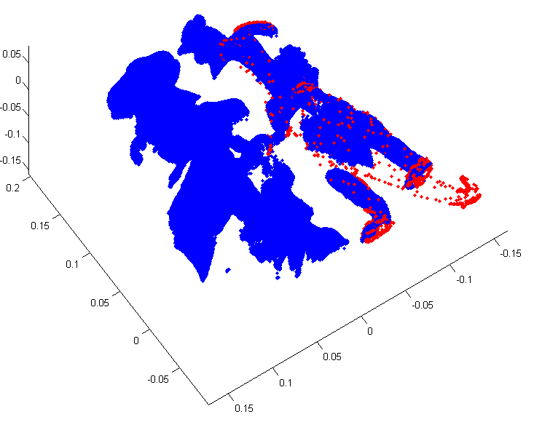
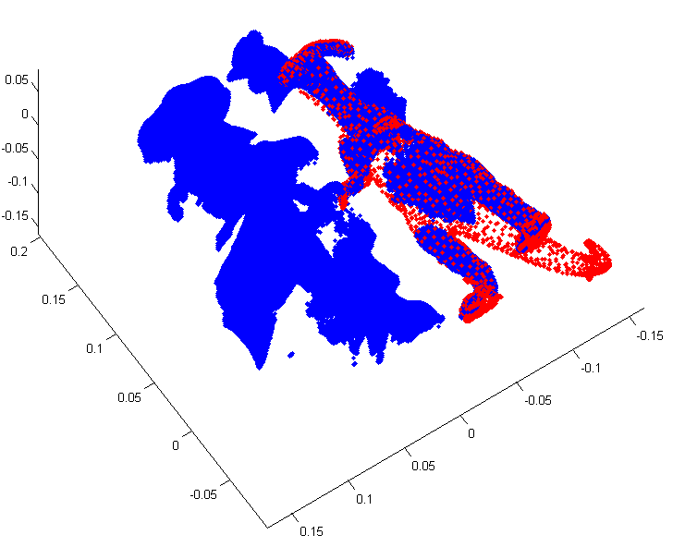
FAST ICP REGISTRATION
Point Cloud Normalization
Robust Registration: Median Absolute Deviations
Coarse to Fine Registration
Linearized Point to Plane Metric
Duplicate Assignment Resolution: Picky ICP
Registration in ~300 ms
Coarsest Level
Finest Level

Slide 8
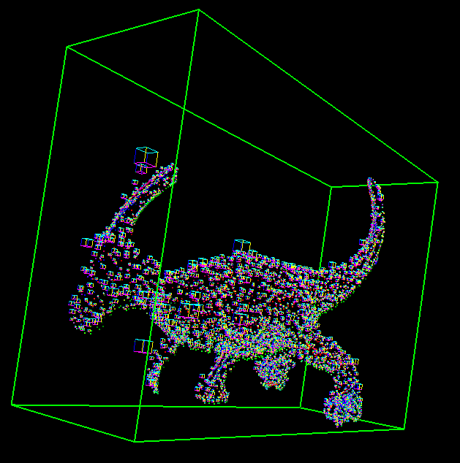
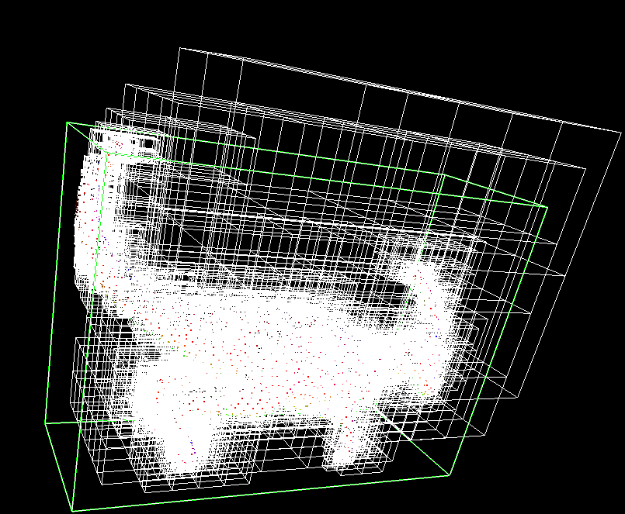
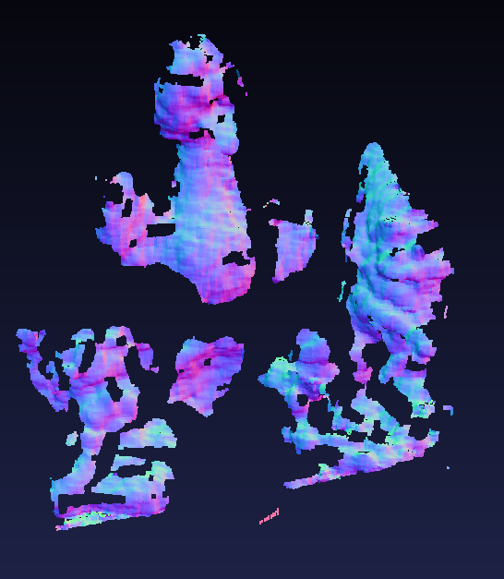
OTHER GAINED FUNCTIONALITIES
Bounding Boxes
Fast Normal Computation of Point Clouds
Voxel Based Quantization of Point Clouds
PLY Reading / Writing
Naïve Hashtable and Various Hashfunctions
PC Normals
Octrees

